Slide 1
Big Data 101:
Session 4

Slide 2
Week 4 – Topics
Project Catchup
WebHDFS Demo
Wordcount Assignment Discussion
Cluster Architecture and Design
Deployment and Management
AWS Cluster Setup Exercise

Slide 3
Some Housekeeping
BigDawg – New Big Data Storage System developed at UW: http://homes.cs.washington.edu/~magda/papers/elmore-vldb2015.pdf
Dataset of Interest – MIMIC II
MIMIC is an openly available dataset developed by the MIT Lab for Computational Physiology, comprising de-identified health data associated with >40,000 critical care patients. It includes demographics, vital signs, laboratory tests, medications, and more.

Slide 4
Projects

Slide 5
HDFS Review

Slide 6

HDFS Architecture
Notes:
NameNode: the master, FS meta data in RAM, metadata ops
DataNodes: storage pool, rack awareness

Slide 7
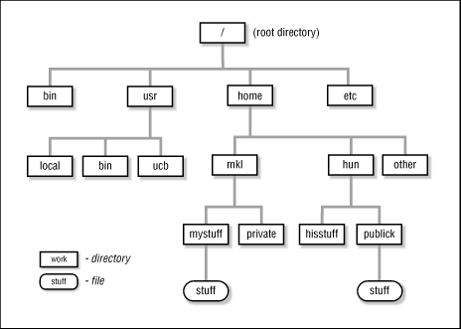
Namenode
In-memory file system
Directory
File
Meta data operation: mkdir, rm, …
Edit log
Checkpoint
Block management

Slide 8
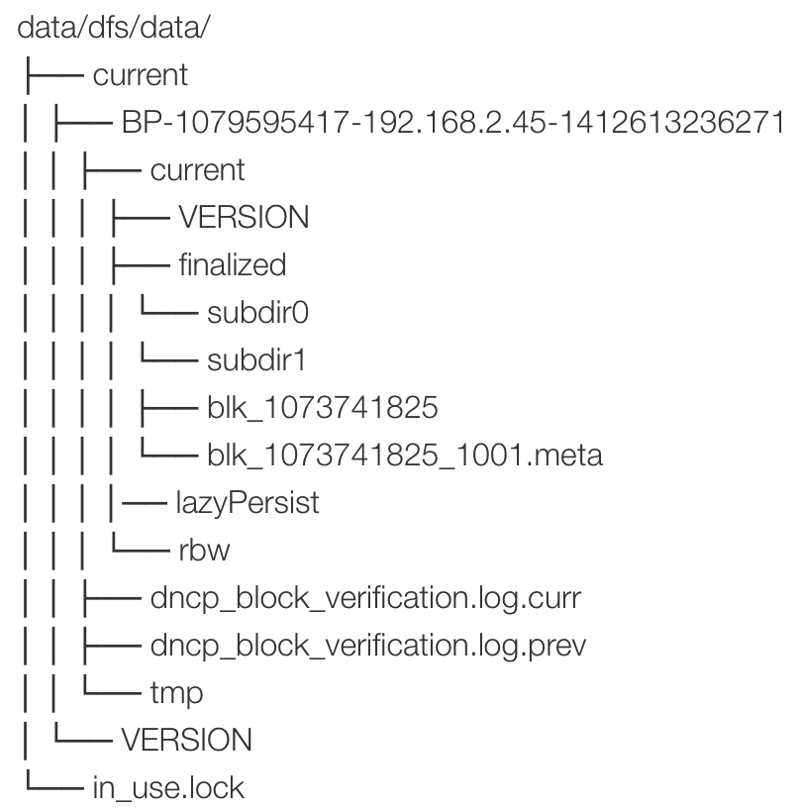
Datanode
Store user data blocks
Store on local file system
dfs/data/current/…/blk_1073741825
Communicate with Namenode

Slide 9
Cluster Architecture and Deployment

Slide 10
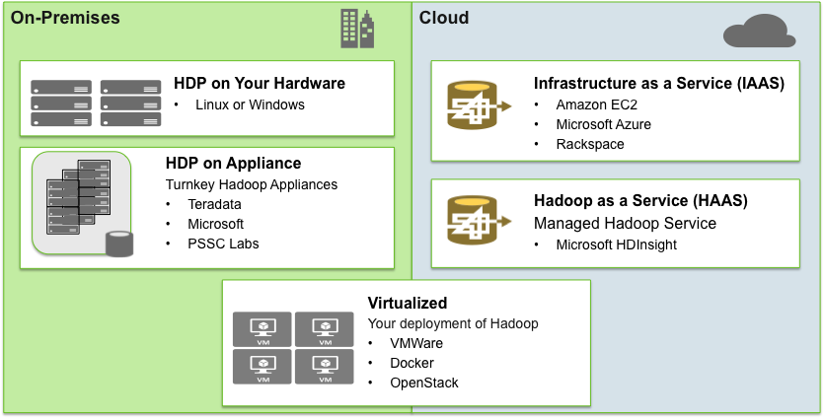
HDP – Flexible Deployment Options

Slide 11
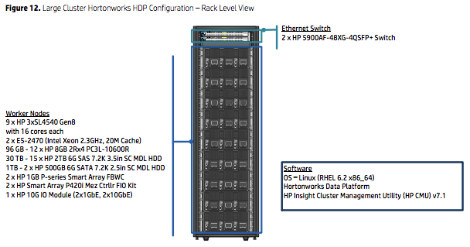
Typical Hadoop Hardware Profiles
Master Nodes – NameNode, Resource Manager , HBase Master, etc.
Dual Intel Xeon E5-2670 Processors
128 GB RAM
6 – 2 or 4TB NLSAS/SATA Drives
Worker Nodes – DataNode, Node Manager and Region Server
Dual Intel Xeon E5-2670 or E5-2690 Processors
128 – 256GB RAM
12 – 4TB SATA/SAS Drives in JBOD (NO RAID!!)
2 – 800GB SSD in RAID 1 for OS
Gateway Nodes
Intel Xeon E5-2650 Processors
8 – 2 TB Drives in JBOD
64 – 128 GB RAM

Slide 12
Why No RAID – an Interlude
RAID is supposed to provide
Fault tolerance
Performance in some RAID modes
HDFS is already fault tolerant
HDFS I/O is geared towards sequential reads, which is achieved by parallelization across drives and nodes
Reference:
Blades, SAN’s and Virtualization in Chapter 4 of Hadoop Operations by Eric Sammer
http://hortonworks.com/blog/why-not-raid-0-its-about-time-and-snowflakes/
http://hortonworks.com/blog/proper-care-and-feeding-of-drives-in-a-hadoop-cluster-a-conversation-with-stackiqs-dr-bruno/

Slide 13

Example Hardware – Dell
Reference Chassis | PowerEdge r730xd
Processor Type | Dual Ivy Bridge E5-26XX v3 Series
Memory Bus | Up to 768GB (24 DIMM slots): 4GB/8GB/16GB/32GB DDR4 up to 2133MT/s
Disk Chassis | HDD: SAS, SATA, Near-line SAS SSD: SAS, SATA 16 x 2.5” – up to 29TB via 1.8TB hot-plug SAS hard drives” 8 x 3.5” – up to 48TB via 6TB hot-plug NL SAS hard drives”
Network Options | 4 x 1Gb, 2 x 1Gb + 2 x 10Gb, 4 x 10Gb
Node Options
Performance
Balanced
Storage
Processor | E5-2690v3 (12c)
Disk | 12 * 2TB + 2 * 300GB
Memory | 512GB
Network | 2x 10GbE
Processor | E5-2670v3 (12c)
Disk | 10 * 2TB + 2 * 300GB
Memory | 256GB
Network | 2x 10GbE
Model | E5-2670v3 (12c)
Disk | 24 * 4TB + 2 * 300GB
Memory | 128GB
Network | 2x 10GbE

Slide 14
Typical Hadoop Rack Topology
Hadoop is deployed as a “Rack Aware” platform so that the data is securely replicated across multiple racks and
the Hadoop services are also deployed across multiple racks, preventing cluster outages and job failures due to a
single or multiple rack failures
Top of Rack Switch: The Top of Rack Switch is responsible for
the management of physical network traffic on the Hadoop cluster
Master Node: The Master Node is responsible for the
Management Oversight of all MapReduce and HBase processes
Gateway Node: The gateway node is responsible for receiving all
Job requests from outside of cluster and submitting for processing
Management Node: The management node is responsible for all
processes related to management and operation of a Hadoop cluster
Worker Node: The worker node is responsible for data storage
along with batch and real time data processing
Worker Node: The worker node is responsible for data storage
along with batch and real time data processing
Worker Node: The worker node is responsible for data storage
along with batch and real time data processing

Slide 15
Small Cluster – With hBase, With HA, With Knox
Master Node 1
Master Node 2
Master Node 3
Master Node 4
Utility Node 1
Admin Node 1
Services Not Included:
Ranger
Storm
Spark
Kafka
Namenode 1
Resource Manager 1
Namenode 2
hBase Master 1
KNOX
Ambari
Zookeeper
Zookeeper
Zookeeper
Hiveserver
Client Gateway
Ambari DB
Oozie
hBase Master 2
Resource Manager 2
WebHCat
History Server
Falcon
Timeline Server
Hive Metastore
Journal Keeper
Journal Keeper
Journal Keeper
Worker Node 1
Worker Node 2
Worker Node 3
Worker Node 4
Worker Node 5
Worker Node 6
Worker Node 7
Worker Node 8
Node Manager
Node Manager
Node Manager
Node Manager
Node Manager
Node Manager
Node Manager
Node Manager
Datanode
Datanode
Datanode
Datanode
Datanode
Datanode
Datanode
Datanode
hBase
Region
hBase
Region
hBase
Region
hBase
Region
hBase
Region
hBase
Region
hBase
Region
hBase
Region

Slide 16
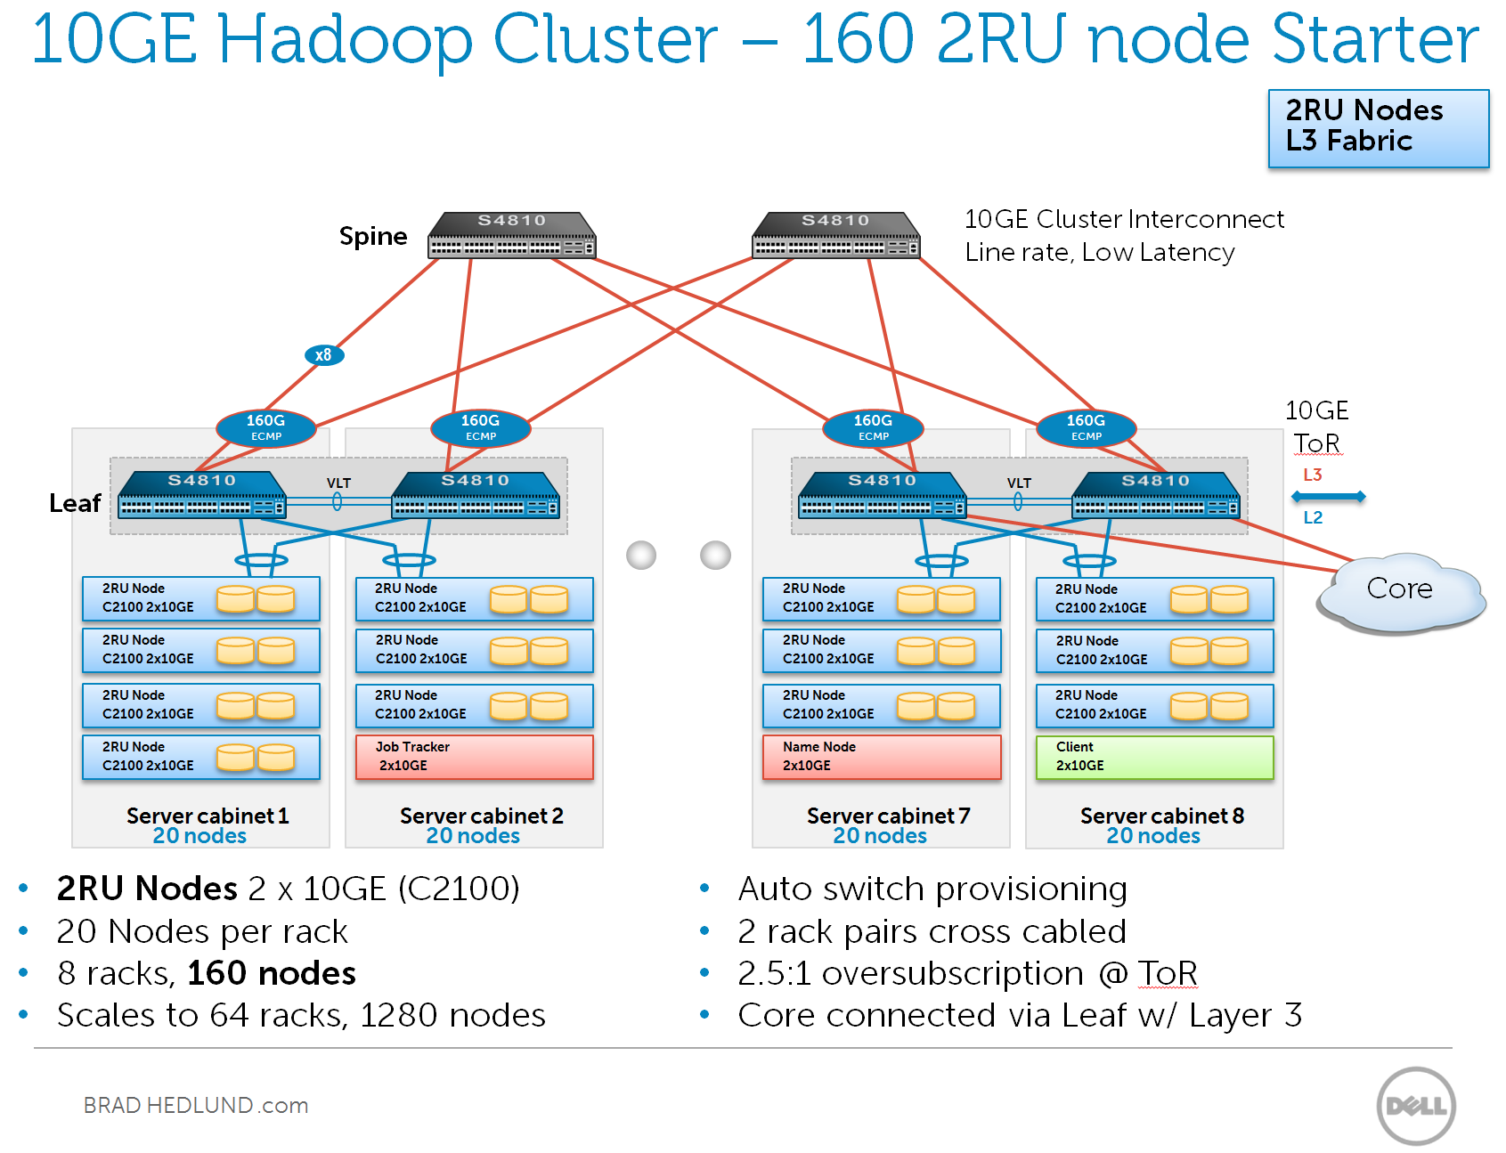
Putting it Together at Scale

Slide 17
In the Cloud
IAAS vs PAAS or HAAS or BDAAS
PAAS or HAAS or BDAAS
Microsoft – HD Insight
Amazon – EMR, Kinesis, Lambda, Redshift, IoT
Altiscale – Altiscale Data Cloud
Google – Big Query, Data Flow, Data Proc
IAAS
Microsoft – Azure
Amazon – EC2
Google – GCE
OpenStack (Private)

Slide 18
Cloud or On Prem
Cloud
On-Prem
Pros
Easy to get started
Elasticity
Cost of Entry
Cons
Ongoing Costs
CAPEX vs OPEX
Performance
Pros
Performance
Control
Security
Cons
Initial Higher Costs
Lower $$ in Long term
Elasticity

Slide 19
Question of the Day
How do we get true elasticity with performance??
Can we marry the benefits of direct attached storage with the benefits of compute growth on demand?

Slide 20
Cluster Management

Slide 21
Cluster Management Lifecycle
Provisioning Server Hardware and OS
Installation of Cluster and Services
Monitoring Cluster Performance
Upgrading Cluster Software Versions
Tuning Cluster Performance
Configuration Management
Commissioning Additional Nodes
Decommissioning Nodes
Tenant (Application and/or User) Onboarding

Slide 22
Cluster Management Tools
In the past there was the command line
SSH and Bash

Slide 23
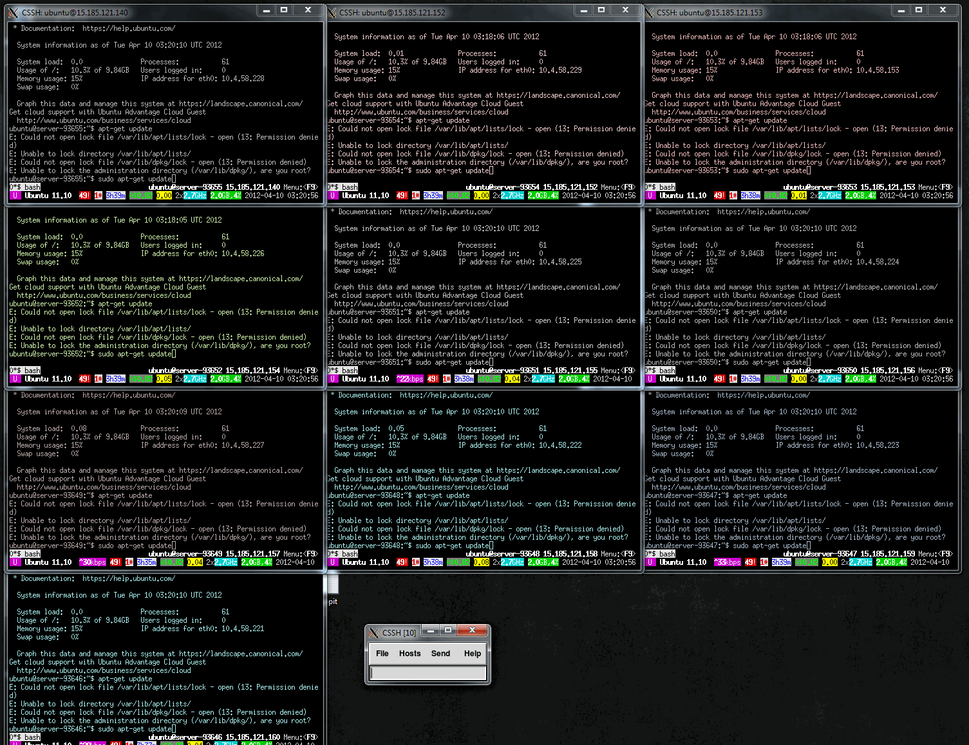

Slide 24
Cluster Management Tools
In the past there was the command line
SSH and Bash
On large clusters this led to . . .

Slide 25


Slide 26
Cluster Management Tools
In the past there was the command line
SSH and Bash
And SysAdmins said there has to be a better way. And then there was Puppet and Chef.

Slide 27



Not a Puppet of a Chef

Slide 28
Cluster Management Tools
In the past there was the command line
SSH and Bash
And SysAdmins said there has to be a better way. And then there was Puppet and Chef. Which led to . .

Slide 29


Slide 30
Cluster Management Tools
In the past there was the command line
SSH and Bash
And SysAdmins said there has to be a better way. And then there was Puppet and Chef.
This was better but was still basically command line. Sysadmins wondered that there had to be a better way. And then there was the GUI Manager like Ambari and Cloudera Manager.

Slide 31
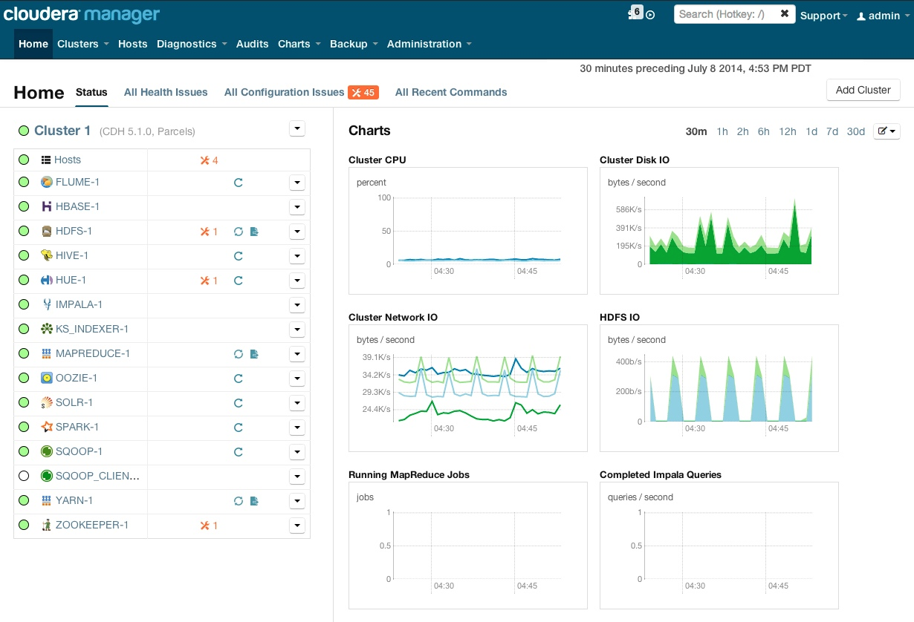
Cloudera Manager

Slide 32
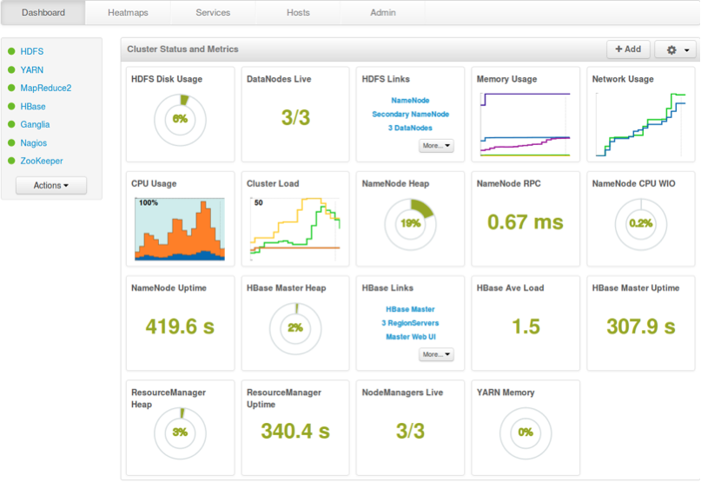
Ambari

Slide 33
Cluster Management Tools
In the past there was the command line
SSH and Bash
And SysAdmins said there has to be a better way. And then there was Puppet and Chef.
This was better but was still basically command line. Sysadmins wondered that there had to be a better way. And then there was the GUI Manager like Ambari and Cloudera Manager.
Which led to . . .

Slide 34


Slide 35
Cluster Tuning
Is an art more than a science
Probably over a 2000 different knobs and dials you can tweak
Most common files:
core-default.xml – 204 Config Parameters
hdfs-default.xml – 223 Config Parameters
mapred-default.xml – 221 Config Parameters
yarn-default.xml – 201 Config Parameters
This does not include Hive, Hbase, Storm, Spark etc

Slide 36
Cluster Tuning Layers
Networking
Do we have enough Bandwidth, is the network configured correctly and securely
Hardware
Are our Disk configured correctly; layout, size partitioning
Operating System
Swappiness, Fiel Access Time, Log Disk Space, Memory, etc
Cluster Services
HDFS, Yarn, Map Reduce, Spark, Storm, Security, etc
Queries and Applications
Hive Query Tuning and Best practices
Application Tuning and best practices

Slide 37
Clusters on EC2

Slide 38
Deploy Options
Long-running Hadoop has different requirement compared to transient Hadoop like EMR
Long-running Hadoop on EC2
Local storage is key
Only use instance store for Datanode data where performance is required
Master node data on EBS
Back up data on S3
Use Hadoop distribution (HDP)
Operation tool, high availability, security

Slide 39
EC2 Storage Options
Instance Stores
Glacier
S3
EBS
EFS
Durability
Performance
Long Term Storage
Online Workloads
http://stackoverflow.com/questions/29575877/aws-efs-vs-ebs-vs-s3-differences-when-to-use

Slide 40
Why Instance Store?
Throughput is important to HDFS
Big block size (128MB)
Optimize for sequential I/O, reduce disk seek time
Data locality is key
Instance store is fast and free.
HDFS handles data durability
EBS is NOT recommended for workloads requiring performance
Network I/O can be bottleneck
Optimized for random I/O

Slide 41
HDD vs. SSD
HDD is good for Hadoop
Prefer EC2 instance type with high disk density
12 or more disks, 1~4TB per disk
 | HDD | SSD
Random IOPS | 100 ~ 180 | 20,000
MB/s | 160 ~ 200 | 400
TB | 4 ~ 6 | 1.2
Cost | $200 | $1000
$/TB/(MB/s) | Low | High
$/TB/IOPS | High | Low
RDB
HDFS

Slide 42
Why Back up to S3?
Cannot get or control EC2 topology
Same hardware? Same Rack?
Placement Group = Rack?
How to back up
Batch: Distcp, Falcon
Double-write by Kinesis / Kafka + Storm to S3 and HDFS

Slide 43
Cluster Instance Sizes
Cluster Size | Node Type | Instance Type
8-20 Nodes | Master | c3.8xlarge d2.2xlarge
 | Worker | d2.4xlarge r3.4xlarge c3.8xlarge
 | Utility | m3.2xlarge
 | Edge | m3.2xlarge
20 – 100 Nodes | Master | r3.4xlarge d2.2xlarge
 | Worker | d2.8xlarge r3.8xlarge c3.8xlarge
 | Utility | c3.8xlarge
 | Edge | m3.2xlarge
100+ Nodes | Master | r3.8xlarge
 | Worker | d2.8xlarge r3.8xlarge
 | Utility | c3.8xlarge
 | Edge | m3.2xlarge

Slide 44
Homework
Complete EC2 Cluster Buildout
Run Wordcount on the cluster
Run some of the MapReduce Examples:
PI on Yarn
Pi on Map reduce
Whats the estimated value of Pi
Whats the difference in speed?
Run Terasort and TeraGen Examples
teragen <num rows> <output dir>
terasort <input dir> <output dir>
Load some files with HDFS and WebHDFS

Slide 45
Additional Sources
Getting Started with Hortonworks Sandbox on Azure – http://hortonworks.com/blog/hortonworks-sandbox-azure/
Ambari on EC2 – http://hortonworks.com/kb/ambari-on-ec2/
Amazon Elastic Compute Cloud Documentation – https://aws.amazon.com/documentation/ec2/?icmpid=docs_menu
How-to: Select the Right Hardware for Your New Hadoop Cluster – http://blog.cloudera.com/blog/2013/08/how-to-select-the-right-hardware-for-your-new-hadoop-cluster/

